Slide 1
‘Reviewer’s job’
The job of the reviewer is not to decide whether a ruling came up with what, in the reviewer’s view, was the rightful outcome or not.
The reviewer’s job is, instead, to determine whether the TDs:
Applied the correct law(s) in the correct way
Followed the right procedure as described in the pertinent Law(s)
Found all the necessary facts
If the case, they presented those facts to the pollees in the correct way
If the case, they asked the pollees the right questions
If the case, they asked the right players

Slide 2
‘Reviewer’s job’
After that process, the reviewer may simply upheld the TDs ruling, or decide otherwise, yet, in the latter case they have options:
- They can say that the Laws and/or Regulation applied were the wrong one(s), or that though correct, they were misapplied. They then instruct the TDs about what are the point(s) of Law(s) or Regulations to be used and how. If they do it, they can refer the ruling back to the TDs or even decide the final ruling by themselves.

Slide 3
Immediate reviewer’s decision
Just a simple example: the TDs applied 64B wrongly, awarding two tricks instead of one. There’s no need to send the ruling back.
However, remaining on revokes, the case might be (it really happened in Poznan 2011: look at the WBF Law Committee minutes of Veldhoven 2011) that TDs misinterpreted Law 64C.
In that case it is not the reviewer’s job to determine the final outcome: they must send the ruling back to the TDs explaining the principle they should follow.

Slide 4
Conflict between the reviewer and the Head TD
What happens if there’s a conflict between the Reviewer(s) and the Head TD about the interpretation of the Laws and/or Regulations?
A regulation covers it: the reviewer prevails, yet, the Head TD has the right to refer the issue to the WBF Laws Committee members presents (if any) in case of Law, the WBF Rules and Regulations, or even the Championship Committee if the matter is an organising one.

Slide 5
The reviewer sends the ruling back
When the Reviewer does not upheld the TDs’ ruling, the most common scenario is, however, sending the ruling back with instructions, Typically:
Including a list of facts to be determined
Including a list of questions to be asked to pollees
N.B. The Reviewer does it even if they think there will be no change: their job is not to decide the final outcome, but to affirm whether the correct procedure was followed or not.

Slide 6
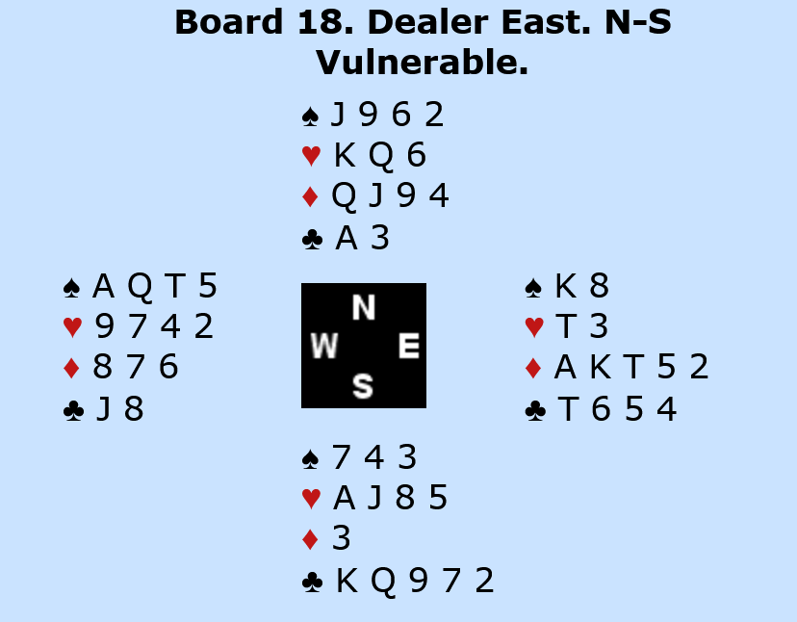
Example 1 – In the heat of the night
The stage of this case is the World Youth National World Teams Championships held in Salsomaggiore Terme (PR) – Italy – from July 12th to July 17th 2025.
At the end of the quarter final match of the Under 26 category between Poland and Sweden the two teams were tied, which called for Poland to go through, since they were the higher qualifier (WBF has dropped extra boards in 2017). Yet, few minutes after the last card had touched the table, Sweden called for a ruling on board 18. Here it is

Slide 7
Example 1 – In the heat of the night
Here I’ll be presenting the table’s facts as shown by the video footage, but to put yourself in the TDs’ and eventually my own shoes, keep please in mind that upon ruling first, then reviewing, the video was not available yet; however, the players’ narration eventually proved to match it very faithfully.

Slide 8
Example 1 – In the heat of the night
After two passes, West opened 2♦, North thought for a while, then looked at the opponents’ Convention Card which she had positioned on her right, against the screen, with the front page to her. She looked twice, then doubled.
What did the CC show? Here is what she saw (however, there was no highlight in the card she was looking at: that was added by myself to help you reading):

Slide 9
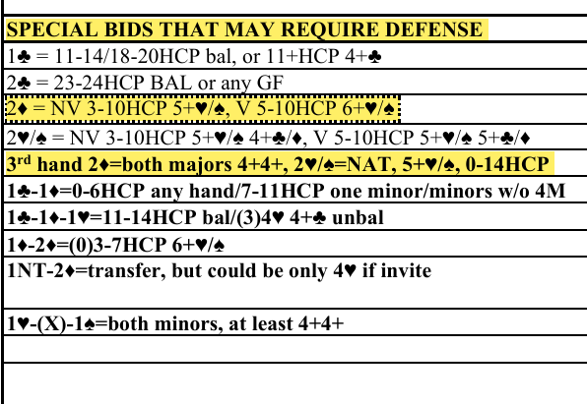
Example 1 – In the heat of the night
As you can see, on the third line you find an explanation which is compatible with “multi”, yet two lines below you are warned that third in hand the meaning is different: both majors 4+/4+.

Slide 10
Example 1 – In the heat of the night
Is this correct?
Certainly not: it was deceiving instead, because that higher line contains an information which looks full and complete, and does not ring any bell. There is no reason why a player should look further down, actually the opposite. And more important, there is no such obligation.
How should it have been written?
That line does explain the difference when it comes to vulnerability: non-vulnerable the opener may have five cards in his major suit and the point range is indicated in 3-10, while when vulnerable the suit must be of six cards or longer, and the point count is 5-10. In the same way, it should also have explained the difference between a first and second hand opening and third in hand opening, and even better, what they would do fourth in hand as well (since that was not mentioned anywhere)

Slide 11
Example 1 – In the heat of the night
North, upon request, explained her double as 13/15 BAL or any 17+, which is marked on NS’ CC as their defence against multi (I cannot offer you the original because they had it online, but I personally saw it, and so had done the TDs before me) . East redoubled, alerting, and North inquired, being told, in writing, “pick your best major” (the two parties agreed on that, though the original paper got lost). At that point she looked a bit puzzled, looked again at the CC, and after a while flipped it over. Here is what she saw on the other side:

Slide 12
Example 1 – In the heat of the night

Slide 13
Example 1 – In the heat of the night
Once again, the correct information was somewhat hidden: at the far right end, and in a column titled “passed hand bidding”, which belongs to bids like the Drury. However here there was a possible clue: on the left is written “1st/2nd” before offering the explanation.
However, North did not find it, and her gestures clearly show that she had not realised the discrepancy.
The auction went on with South’s pass, West 2♠ , and after two passes South bid 3♠ and North concluded the bidding with 3NT, which went down one when East led the ♦A, then switched to ♠K and the defenders cashed out their five winners.

Slide 14
Example 1 – In the heat of the night
Here is the entire auction:
East South West North
Pass Pass 2♦ DBL
RDBL Pass 2♠ Pass
Pass 3♠ Pass 3NT
All pass

Slide 15
Example 1 – In the heat of the night
After a while, when the new board had been placed on the table and the screen had been closed, the full hand popped up on the tablet’s screen, and North clearly showed that she had finally realised that something had gone wrong with the information, and asked her screenmate for clarification. Only then East pointed at the correct parts of the CC. North did not take any action.
So what Sweden claimed, at 20.05, in the very hot and extremely humid Salso’s evening? That North had been deceived by the opponents’ CC: had she known the real meaning of 2♦ she would not have doubled (she was not asked, at that stage, what their method against the real 2♦ was, if any). If she hadn’t, they would not ended up in an hopeless contract. Since at the other table the final contract had been 2♦ -1 by EW, Poland +50, the board had had a cost of four IMP to Sweden, but any plus score at the other table would have been enough to swap the final result.

Slide 16
Example 1 – In the heat of the night
The TDs then grouped together, and spent half an hour discussing a preliminary point which might well be decisive, and would not require any further investigation: did North do all her best to find out the real meaning of 2♦ or not? In simple words: had she been lazy, negligent, or careless? Technically spoken, this kind of approach is related to a part of the regulation which calls for a player to protect themselves when it is clear that something does not correspond to what they see and/or read (e.g. some bid they expect to be alerted, it isn’t), and the required level of self-protection increases as the level of the competition raises up.
So, was it a case of lack of self-protection or not? The TDs debated at length, and in the end they split equally: three on one side and three on the other, eventually deciding for a “yes” when they found out about the written explanation about the redouble. Yet, doubts still remained amongst them.

Slide 17
Example 1 – In the heat of the night
The ruling was delivered, and Sweden left, but about twenty minutes later – the right to ask for a review expires after thirty minutes – upon sitting down for dinner and finally enjoying some proper conditioning in our dinner room, I received a call: Sweden wanted the decision to be reviewed.
I asked the permission to finish dinner first, granted, and at the end, escorted by the Head TD Marc van Beijsterveldt and Chief TD Rahmi Ilic I started the journey toward Sweden’s hotel, where we arrived covered in sweat despite the short distance.
There Marc presented the case, starting with facts as he knew them (as stated before, he had not seen the video, yet his facts were proven to be pretty accurate), then going through the decision’s motives. In doing so, he clearly stated repeatedly that in his opinion North had done all she could to learn about the opponents’ method (but I already knew Marc had been on the side contrary, or at least sceptical, to the final ruling). Then, North was interviewed: she was asked why she had not understood the meaning of 2♦ (“I only read the front page and since that line contained a full and not contradictory information I did not investigate any further”), then why she had not realized there was the need for some further inquiry when the explanation of the redouble came to her. To that question, she replied that she had done it (as proven by the video) but when she had found only the part on the left she had thought that the contradiction had come from a language problem. Furthermore, with the two calls already passed through the screen she thought it was too late to change her double.
Then Sweden’s captain and coach were heard, and they both stated that in their opinion North had not had a real chance to suspect that the information available to her was deceiving.

Slide 18
Example 1 – In the heat of the night
It was then time to analyse the facts and the points of laws and regulations. I already quoted the “lack of self-protection” principle, as for the rest, Law 40 is the primary reference (“Partnerships agreement”), then the System Policy and the Alerting Policy, not to forget about the guide to the compilation of the CC.
Law 40 calls for full and clear disclosure of ones’ agreements, and the two quoted policies plus the instructions about filling a CC put altogether a heavy burden on the players’ shoulder, calling for them to be extremely clear in writing documents and giving out information, and for a proactive role when suspecting that a misunderstanding might have occurred.
Had, then, been possible for North to realise that something was wrong before doubling 2♦? May be yes, reading below, but it was certainly not her fault not doing it, since the information she read was complete and exhaustive, and nothing in that line rung any bell.
Had she any obligation to flip over the CC and look on the other side? No, there’s no such requirement in any part of Laws and/or regulations, and as already said, she had no reason to be suspicious.
Could East have done any better at that stage? Certainly yes. He might well have realised that her screenmate was looking at the wrong line, and he could, and probably should in light of the aforementioned obligation, volunteered a clarification (that was pointed out by Marc as well). So up to that point the requirements to apply the “lack of self-protection” principle were not met.

Slide 19
Example 1 – In the heat of the night
Were they applicable later, after the redouble? This is a more arguable point, but it is easily solved looking at the video, which eventually confirmed North’s statement: it is evident that though she was puzzled reading it, eventually she found on the other side an explanation that matched her idea that there was some language problem. In any case, two more points here are decisive: a) whenever there’s a doubt, you should always go in favour of the non-offending side and b) with the auction already on the other side it was extremely unlikely for her to receive a correct information before her partner had bid, which means that there were almost no chance that she could have been allowed to withdraw her double.

Slide 20
Example 1 – In the heat of the night
Let me stretch it once more: EW had filled the CC in a very bad and deceiving way, certainly contrary to the regulations, and that was entirely their fault, not the opponent’s.

Slide 21
Example 1 – In the heat of the night
At the end, I ruled that the “lack of self-protection” criteria had not been met, and asked the TDs to rule of the basis of misinformation. But that was not so easy, and called for some more instructions and investigation. What I asked for was:
To check about what method NS were using against a 2♦ opening which shows both majors as described;
If available, to poll players about what would have happened without the infraction (the MI);
If not available, to ask the reason why North would have passed instead of doubling, and to poll players about what they would have done in the same situation and why;
To poll players about what they would have done, with the East’s cards, over 2♦ -Pass;
To poll players about the subsequent auction in the different scenario(s) created by the previous answers.

Slide 22
Example 1 – In the heat of the night
The TDs started asking NS about their method, finding out they had nothing written about it. Then asked the reason behind the alleged pass, and they learnt that a double would promise 15+ with the minors or any much stronger hand. That explanation is indeed consistent with many other pairs’ approach, with bridge logic (there are only two suits available so the situation is more dangerous), and with the subsequent action: south’s 3S is indeed consistent with a stronger partner than with a player who may merely hold 13 HCP.
Anyhow, players (seven) were interviewed asking them what they would have done with North’s cards, specifying what was the method used over 2♦ multi, but they did not have an agreement over that 2♦. They all passed.
Then players were asked what they would have done over 2♦ with East’s card after a pass on their right: most passed and a minority (two) bid 2 ♥.
Then players were asked what they would have done with NS’ cards in both cases. After 2♥, nobody took any action, while after pass one doubled and six passed.
The last question asked was what they would have done with North’s cards after 2♦ -pass-pass-double-pass: some bid 2NT and some passed. Nobody bid 3NT.
The last piece of information that I owe you is that 2♦ failed at all other tables whenever played undoubled, and made once, when doubled. If you analyse the hand, you find out that the contract should always go down.

Slide 23
Example 1 – In the heat of the night
If you followed carefully, you can now come to the same conclusion of the TDs: the result must be adjusted, and the correct adjustment is a weighted score (see Law 12), yet there’s no need to calculate it: anyone certainly leads to a few IMPs to Sweden, but even 1 IMP was enough.
All that took more than an hour, but since that was a new ruling, it was subjected to review, and as you may imagine, as soon as the Polish captain received the bad news he asked for it, and you cannot blame him for that.
Another journey through the incandescent night took us where the Polish team was staying, and more sweat was poured out. It followed a long interview about the reasons for the first decision (though it was not appealable anymore: reviews are final), and the second. The TDs and myself offered both, explaining in details – the ones you read - the procedure we had gone through. At the end they understood it and accepted it, yet, they asked me to please check the video to confirm facts, which I duly did in the early morning, since it was midnight and going through the footage was not possible at that hour.
The video confirmed the facts, and the ruling stood.

Slide 24
Example 2 – Last breath
The stage of this case is the World National World Teams Championships held in Herning – Denmark – from August 18th to September 1st 2025.
At the end of the quarter final match of the Women category between Poland USA 2 the two teams were tied, which called for USA 2 to go through, since they were the higher qualifier (WBF has dropped extra boards in 2017). Yet, few minutes after the last card had touched the table, Poland called for a ruling on board 24 . Here it is
West North East South
Zur-Camp.S Baldysz Seamon-M.C Baldysz
Pass 1♣ Pass 1♦
Pass 1NT Pass 2♣
Pass 2♦ Pass 2NT
Pass 3NT All Pass

Slide 25
Example 2 – Last breath
The Facts:
North called the Director after the board, stating that she had been misinformed by
the mention on the System Card. Under Leads, vs NT, Jack, it said “Q or shortness”.
She had read the ♥J as a doubleton or QJ fourth. So when East produced a third heart, she had put the ♥Q there as well.
The Director:
Saw, when pointed out by East/West, that one line higher and two lines lower, shortness was explained as (<4), but ruled that the absence of the same explanation in the correct place meant that Declarer had been misinformed. When checking for a piece of information in the correct place, a player is not required to look elsewhere for an explanation that seems obvious.
The Director then presented the bidding, the lead of the ]J, and a correct mention on the System Card of “♥J=♥Q or <4” to a series of experts. Some of the experts chose lines that would lead to success.
West North East South
Zur-Camp.S Baldysz Seamon-M.C Baldysz
Pass 1♣ Pass 1♦
Pass 1NT Pass 2♣
Pass 2♦ Pass 2NT
Pass 3NT All Pass
Contract: Three No-Trump, played by North. Lead ♥J
Result: 8 tricks, NS -50

Slide 26
Example 2 – Last breath
Ruling:
Score adjusted to
1/3 of 3NT, by North, 9 tricks: NS+400 and
2/3 of 3NT, by North, 8 tricks: NS-50.
The score in the Closed room had been 3♣N+1, +130
So the balance gave 1/3 of +7IMPs + 2/3 of -5 IMPs = -1 IMP
The original score of -50 had given a balance of -5 IMPs,
so the final score of the match (by now finished) was turned over from a win by 1IMP in favour of USA2, into a win for Poland by 3 IMPs.
East/West asked for a Review.
Players’ reason to ask for review:
Apart from wanting a review of the ruling, East/West believed that North had misplayed, even given the wrong information. She should always have made her contract.

Slide 27
Example 2 – Last breath
The Reviewer:
Asked the Director who the experts were. There were 7 pollees, 3 at the venue and 4 from their homes in 3 different countries.
The Reviewer pointed out to East/West that the Laws state that in the case of misinformation, the score shall be corrected to the result that could have been reached with correct information. The actual happenings after the misinformation do not matter (except in the case of Extremely Serious Error or Gambling action – Law 12C1e).
The Reviewer’s decision:
Director's ruling upheld.
Deposit: none asked, given the extreme long time to reach the decision (it was given to the players more than 90 minutes after the end of play).

Slide 28
Example 3 – Brothers, knives
The Facts:
North called the Director after the board, stating that she had been misinformed by
the mention on the System Card. Under Leads, vs NT, Jack, it said “Q or shortness”.
She had read the ♥J as a doubleton or QJ fourth. So when East produced a third heart, she had put the ♥Q there as well.
The Director:
Saw, when pointed out by East/West, that one line higher and two lines lower, shortness was explained as (<4), but ruled that the absence of the same explanation in the correct place meant that Declarer had been misinformed. When checking for a piece of information in the correct place, a player is not required to look elsewhere for an explanation that seems obvious.
The Director then presented the bidding, the lead of the ]J, and a correct mention on the System Card of “♥J=♥Q or <4” to a series of experts. Some of the experts chose lines that would lead to success.

Slide 29
Example 3 – Brothers, knives
The Facts:
South realized that he had mistakenly passed and wanted to change his first call, claiming that it had been a misclick. He called the Director by pressing the appropriate key on his tablet and told West not to bid. West acknowledged this but bid anyway. Since the bidding was performed on tablets, these bids appeared immediately on the other side (no possibility for South to withhold a tray). When the Director arrived at the table, North had already called.
The Director:
Ruled that after North has bid, it is too late for South to change his bid according to L25A.
The play had to continue.
Ruling:
Play continues, table result stands.
North/South asked for a Review.

Slide 30
Example 3 – Brothers, knives
Players’ reason to ask for review:
The Director had not taken into account that West had committed an infraction by taking action before the Director arrived at the table.
The Reviewer:
ruled that the Director had unwittingly made an error in the ruling. The ruling must be made again. Several points remain to be examined: was South's pass unintended? Has West committed an infraction? Should North have waited for the Director? What would the final outcome have been if the Director had ruled immediately after arriving at the table?
The Reviewer’s decision:
Ruling referred back to the Director.

Slide 31
Example 3 – Brothers, knives
Subsequent action by the Director:
The Director watched the video and was not convinced that South's pass was unintended. That meant that it could not be changed and that the table result should stand.
However, West did break L9B2 (No player shall take any action until the Director has explained all matters in regard to rectification). East/West receive a procedural penalty of 3 IMPs.

Slide 32
Climbing on a mirror

Slide 33
Climbing on a mirror
The Facts:
East had explained 4NT to North as “any 2 suits”. West had alerted it but was not asked about the meaning. East explained 5♦ to North as “diamonds and hearts”. West believed 4NT showed the minors, which is why she passed on 5♦, but when that was doubled she ran to 5♥.
The Director:
Started by explaining that the opponents are entitled to a correct description of the system, but not that there are different opinions and explanations on the other side of the screen. If North gets the explanations that South got, she will still double 5♥
Ruling:
Score stands
North/South asked for a Review.

Slide 34
Climbing on a mirror
The Facts:
East had explained 4NT to North as “any 2 suits”. West had alerted it but was not asked about the meaning. East explained 5♦ to North as “diamonds and hearts”. West believed 4NT showed the minors, which is why she passed on 5♦, but when that was doubled she ran to 5♥.
The Director:
Started by explaining that the opponents are entitled to a correct description of the system, but not that there are different opinions and explanations on the other side of the screen. If North gets the explanations that South got, she will still double 5♥
Ruling:
Score stands
North/South asked for a Review.

Slide 35
Climbing on a mirror
Players’ reason to ask for review:
The double of 5♥ is not the point of their case, the double of 5♦ is. North/South believe that the correct explanation should have been “no agreement”, in which case North would have refrained from doubling 5♦. Even if 4NT showed minors, North would not double 5♦ out of fear of a better club fit.
The Reviewer:
The second point is clearly illogical: the opponents were in 5♣ and ran away from it. But players should be polled about what North would do with the explanation “no agreement”.
The Reviewer’s decision:
A new poll should be held.

Slide 36
Climbing on a mirror
Deposit:
Though formally the information to be given was "no agreement", it was clear that the outcome would not change, since east's sequence was evidently coming from a red two suiter, so the request was preposterous and very close to be deemed frivolous.
The deposit was returned.
Subsequent action by the Director:
Four players were polled, confirming unanimously that the explanation makes no difference. The table result was allowed to stand.

