Slide 1
9th EBL NBO Officers’ Seminar
Teaching bridge
to
young people in Greece
By Vassilis Virvidakis
European Bridge League

Slide 2
9th EBL NBO Officers’ Seminar
First steps (1965-1971)
1965 – Founding of HBF
1967 – First Appearance of Greek Open National Team (26th European Championship, Dublin)
1969 – First Appearance of Greek Women Team (27th European Championship, Oslo)
1971 – European Games in Zappeion
European Bridge League

Slide 3
9th EBL NBO Officers’ Seminar
Growing up (1972-1986)
1972 – ΕΛΠΑ (Greek Touring and Car Club) – First club for young people (U35)
1974 – First appearance of Greek Junior Team 19/20 (4th European Junior Championship, Copenhagen)
1978, 1980, 1984, 1986 Greece participates in European Junior Championships
European Bridge League

Slide 4
9th EBL NBO Officers’ Seminar
Golden Period (1987-1989)
1987-1988 Program for Juniors
1987 Golden Medal in 11th ECC Junior Pairs Kapayiannidis-Liarakos, Valkenburg
1988 Junior Team 5th in 11th European Junior Championship, Plovdiv
1988 Open Team 5th in 8th Olympiad, Venice
1989 Women Team 3rd, Open Team 4th in 12th European Community Bridge Championships, Oostende
European Bridge League

Slide 5
9th EBL NBO Officers’ Seminar
Stagnation (1990-2015) and
Explosion (2015-2017)
1992, 1994, 1996, 1998, 2002, 2004, 2005, 2007, 2009, 2011, 2015, 2017 Greece participates in European Junior Championships
2017 Silver medal for a Greek team in 8th European Open Championship (Montecatini)
2017 First Appearance of Greek Kids Team (U16) 9/16 (2nd European Kids Championship, Samorin)
European Bridge League

Slide 6
9th EBL NBO Officers’ Seminar
European
Pairs U26 Championship 2010 Opatija
Winners
Vroustis-Doxiadis
European Bridge League

Slide 7
9th EBL NBO Officers’ Seminar
Teaching Kids History
Individual efforts at Varvakios School and some provincial schools as well as at NTUA (twice)
HBF assigned (5/2008) the adaptation - translation of the French version (Source WBF) of the mini bridge method in Greek. The complete method was delivered to HBF (25 lessons, containing 3 text files per teacher and 3 per student, in 12/2008)
Spring of 2009: four boys and two girls were the first kids who followed mini bridge courses
European Bridge League

Slide 8
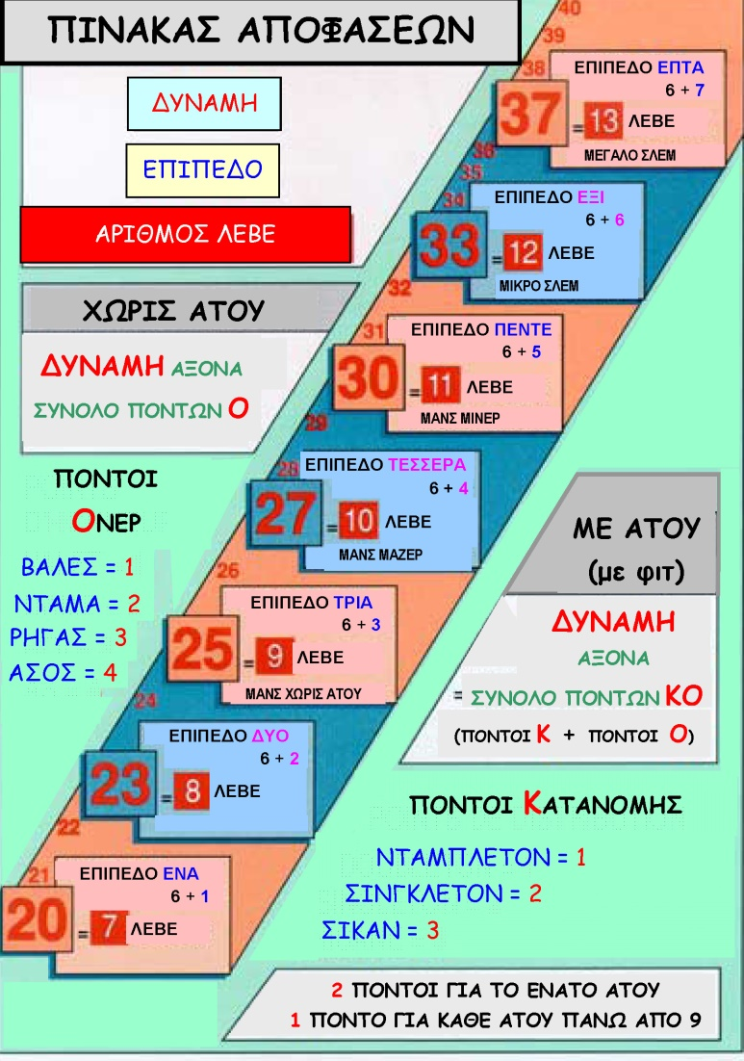
9th EBL NBO Officers’ Seminar
European Bridge League

Slide 9
9th EBL NBO Officers’ Seminar
Kids Program (2014)2015-2019
Athens
September 2015. Group of 8 kids learning mini bridge. Saturday lessons in a club (their parents are bridge players)
September 2016. The kids pass from mini bridge to Audrey Grant (official method of HBF for adults)
2016. Permission given to introduce bridge in elementary schools
January 2017. The Municipality of Athens, within Open Schools Activities, invited HBF to teach mini bridge to about 50-60 kids (10-11 years old) in ten elementary schools (multicultural composition)
2017. Permission renewed and expanded to high schools
October 2017. Two elementary schools (20 kids) join the Open Schools program
European Bridge League

Slide 10
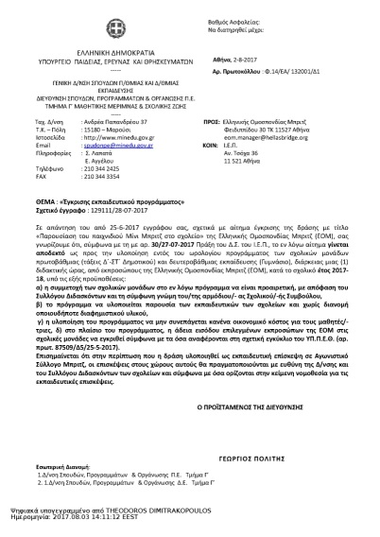
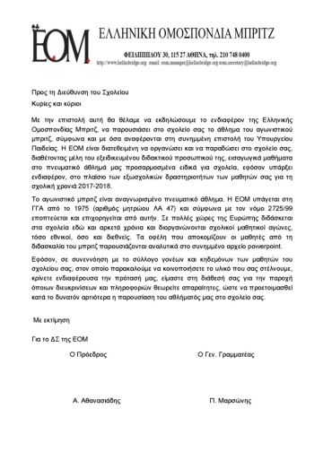
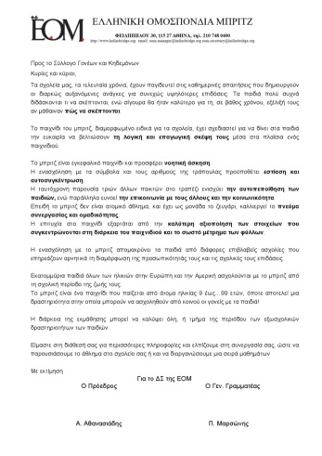
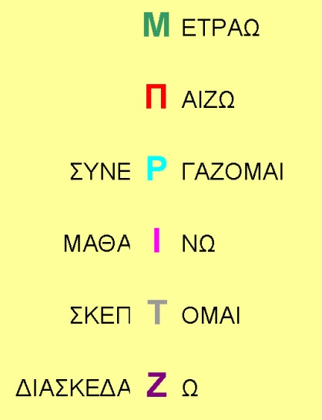
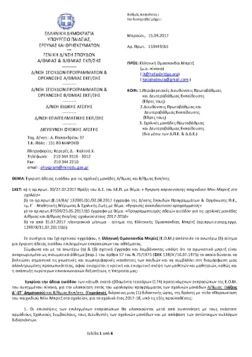
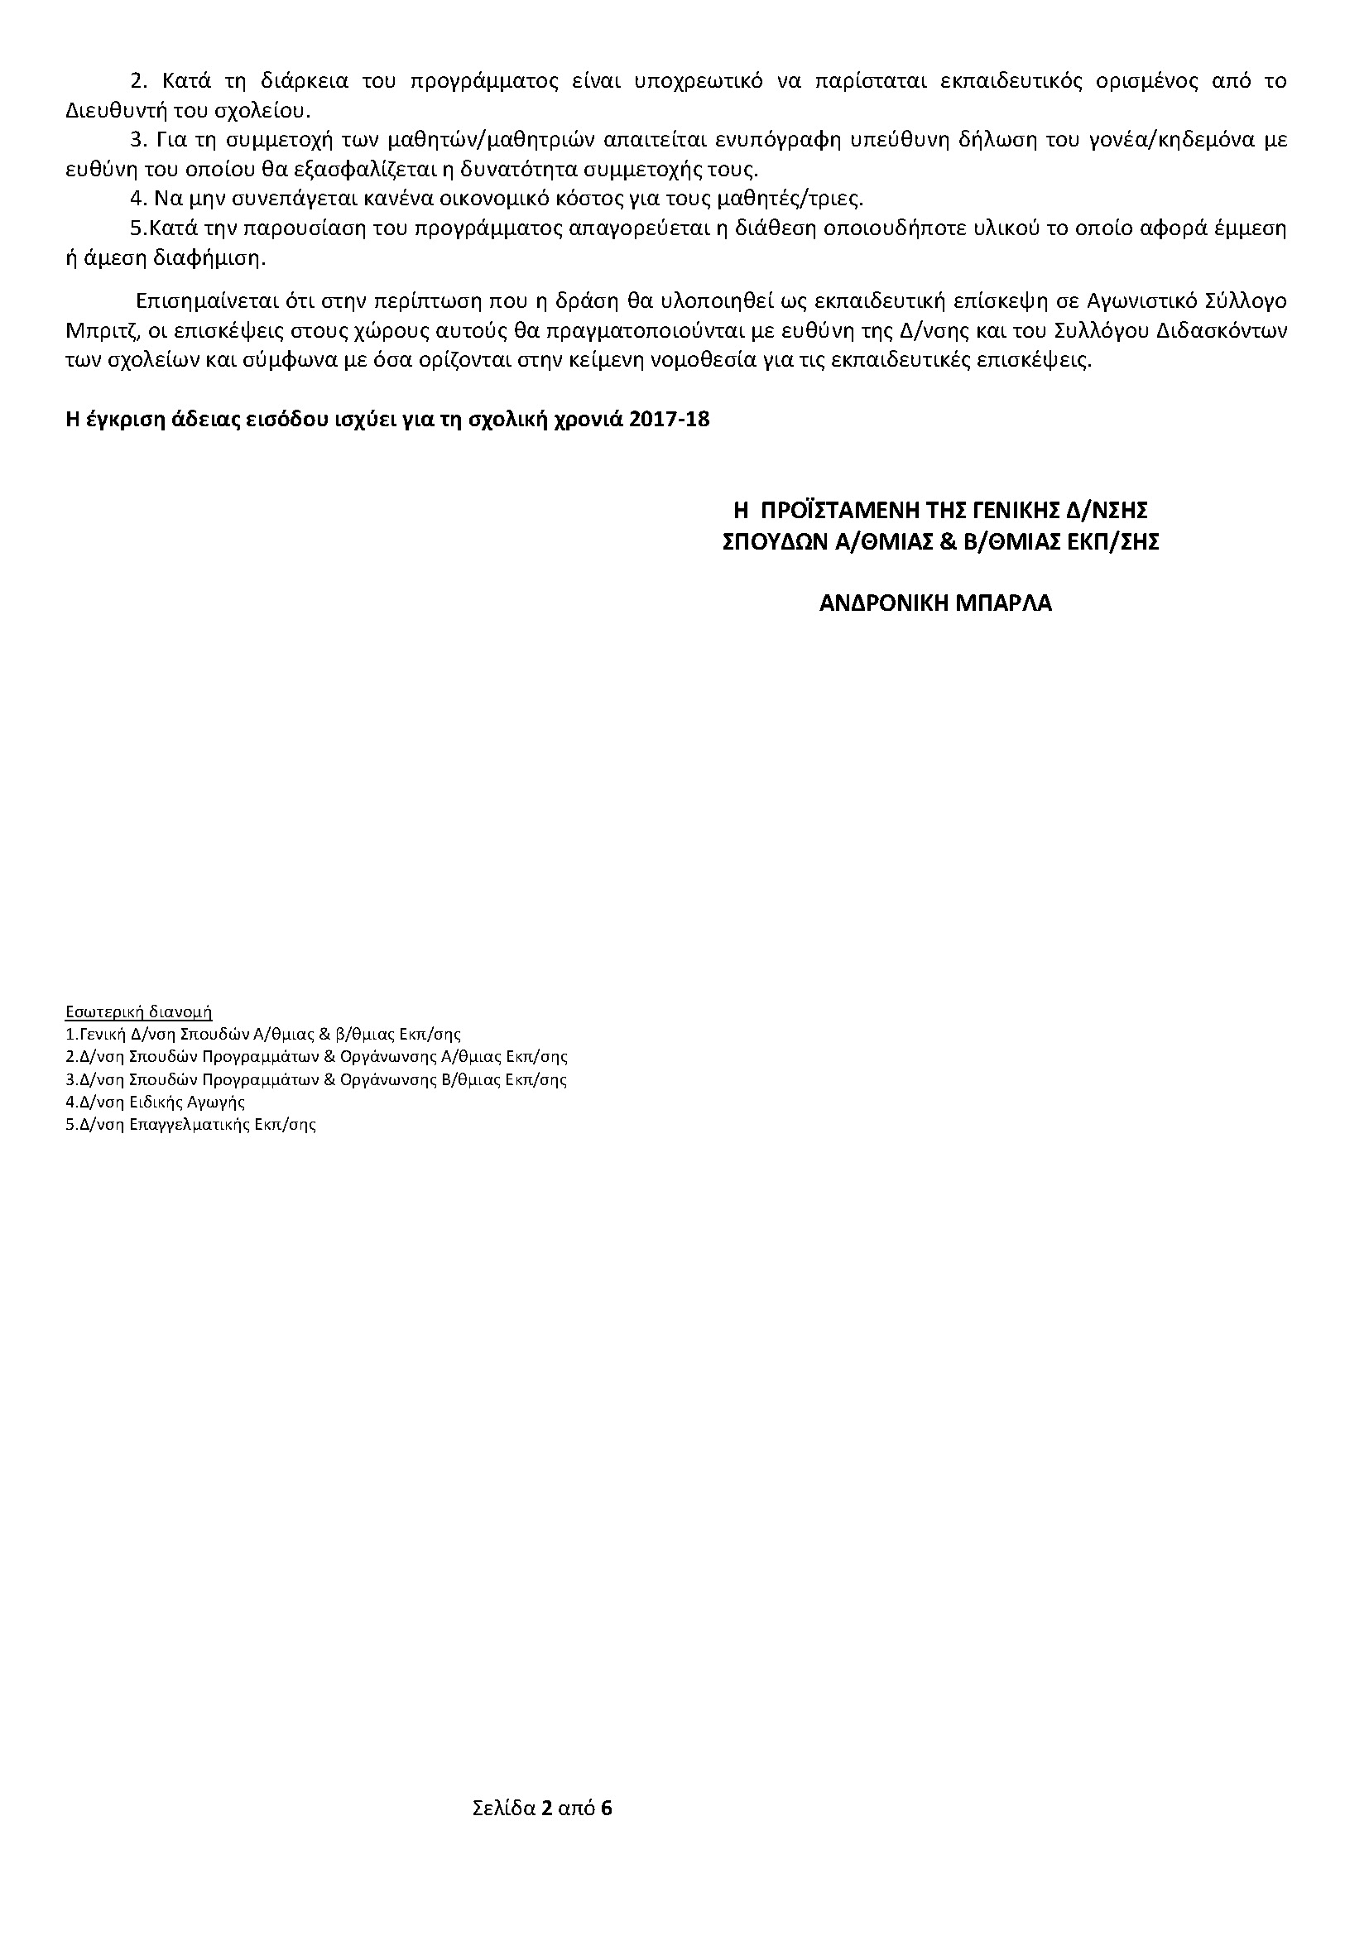
9th EBL NBO Officers’ Seminar
Useful Documents
Ministry of Education Permission
Letter to School Director
Letter to Parents Association
European Bridge League

Slide 11
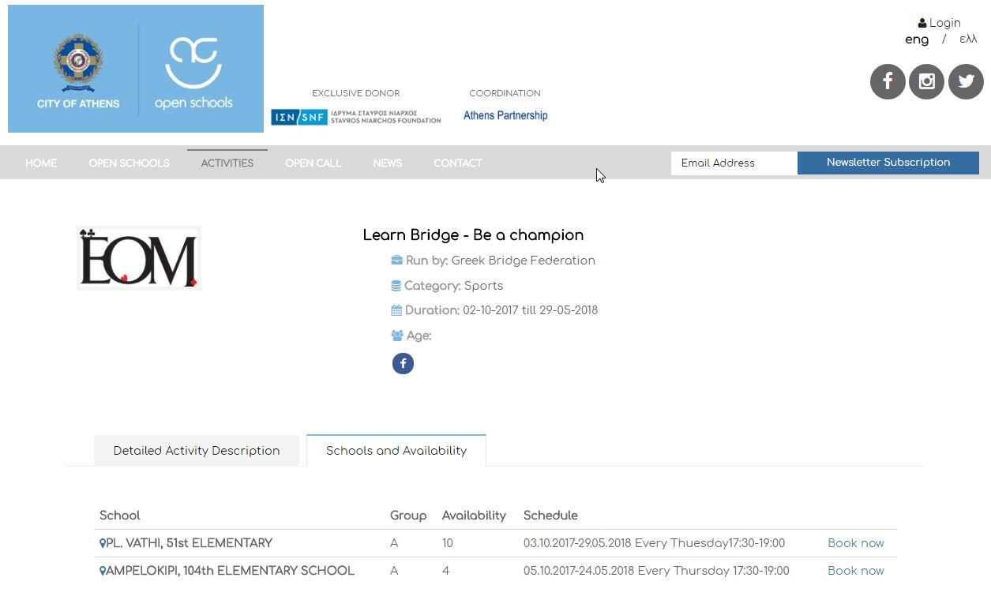
9th EBL NBO Officers’ Seminar
Municipality of Athens Web Page
European Bridge League

Slide 12
9th EBL NBO Officers’ Seminar
Kids Program (2014)2015-2019
Necessity for Teachers
Examinations 2015, 2016
Forty subjects containing mini bridge issues as well
European Bridge League

Slide 13
9th EBL NBO Officers’ Seminar
Kids Program (2014)2015-2019
Profile of a kids Instructor
Pleasant - funny
Young (U35) – preferably female
School teacher or professor if possible
Bridge Instructor
European Bridge League

Slide 14
9th EBL NBO Officers’ Seminar
Kids Program (2014)2015-2019
…at a local club in a provincial town
Kalamata (Peloponnese) case
16
2013: 2 (2)
2014 : 3 (3)
2015 : 13 (9)
2016 : 15 (12)
2017 : 21 (+ ∼30 in school project)
2018/01/20 : 16 pairs play in a kids session
5
European Bridge League

Slide 15
9th EBL NBO Officers’ Seminar
Kids Program (2014)2015-2019
Serres (Macedonia)
2016: 1 (1)
2017: 12
following lessons in
the local club
6
6
2018 Larissa (Thessalia) 30 in club + 20 in school
Future objectives: Agrinio, Kavala, Thessaloniki, Patra
European Bridge League

Slide 16
9th EBL NBO Officers’ Seminar
Social Activities
September 2017. Be active – Cyprus
October 2017. HBF participated to the Scholar Sports Day (presentation to 160 students of a high school)
2018. Kids, bridge athletes, are invited, by Education Ministry, to present the game to disabled children
European Bridge League

Slide 17
9th EBL NBO Officers’ Seminar
Kids Program (2014)2015-2019
2014 – 2015
Function | Responsible officer / Club of HBF | Cost
Exploratory Year – No official function from HBF | Mr. Dimitris Papaspyrou investigates the opportunities of a Kids program | None
Action Plan 1st Year (9/15-6/16)
2015 – 2016: 1st year (September 2015 till June 2016)
Function | Responsible officer / Club of HBF | Cost
1st year of official kids program in two clubs: OAMLE (Athens) and OAMK (Kalamata) | ● Mrs. Marianna Koroni teacher in OAMLE group of Kids (Athens) October 2015 –May 2016 (about 25 lessons 2 hours long) | 750 €
 | ● Mr. Vasilis Rousseas teacher in OAMK group of Kids (Kalamata) October 2015 –May 2016 (about 25 lessons 2 hours long) | 750 €
 | ● Operating expenses for the Kids Program [OAMLE (Athens) ] | 200 €
 | ● Operating expenses for the Kids Program [OAMK (Kalamata) ] | 200 €
Kids tournaments | ● 1st Kids session (28.12.2015), OAMLE (Athens) | 100 €
 | ● 1st Kids National Champion (23-24 April 2016) AOM (Athens) | 300 €
 | ● Kids tournament in major Festivals [OAMK (Kalamata), OAMKI (Kifissia) ] | 150 €
 | ● HBF Open National - wide teams tournament (7-9 October 2016) Kids tournament (pairs) | 300 €
 | ● Various expenses (Gifts, trophies etc.) | 250 €
Evaluation of the program | ● Mr. Dimitris Papaspyrou as Coordinator of the program | None
Administrative Support | ● Hellenic Bridge Federation (Officers & Employees) | None
 |  | 3000 €
*Programming of the year 2015-2016 was completed without any deviations from the above plan
European Bridge League

Slide 18
9th EBL NBO Officers’ Seminar
Kids Program (2014)2015-2019
Action Plan 2nd Year (9/16-6/17)
2016 – 2017: 2nd year (September 2016 till June 2017)
Function | Responsible officer / Club of HBF | Cost
2nd year of official kids program in two clubs: OAMLE (Athens) and OAMK (Kalamata) 1st year students and newcomers (two groups in each club) | ● Mr. Vasilis Virvidakis teacher in OAMLE group of Kids (Athens) October 2015 –May 2016 (about 25 lessons 2 hours long for 2 groups) | 1500 €
 | ● Mr. Vasilis Rousseas teacher in OAMK group of Kids (Kalamata) October 2015 –May 2016 (about 25 lessons 2 hours long – 2015-2016 group) ● Mrs. Villy Filopoulou Kids teacher in OAMK (Kalamata) October 2015 –May 2016 (about 25 lessons 2 hours long – Newcomers group) | 750 € 750 €
 | ● Operating expenses for the Kids Program [OAMLE (Athens) ] | 400 €
 | ● Operating expenses for the Kids Program [OAMK (Kalamata) | 400 €
Kids tournaments | ● Christmas Kids session (29.12.2015), OAMLE (Athens) | 100 €
 | ● 1st Kids National Champion (23-24 April 2016) AOM (Athens) | 300 €
 | ● Kids tournament in major Festivals [OAMK (Kalamata), OAMKI (Kifissia) ] | 150 €
 | ● HBF Open National - wide teams tournament Kids tournament (pairs) | 300 €
 | ● Various expenses (Gifts, trophies etc.) | 250 €
Summer Camp | ● Mr. Dimitris Papaspyrou as Coordinator of the program ● Mr. . Vasilis Virvidakis as head coach ● Trainers of HBF ● Duration: 40 days (2 summer camp periods) | apr. 6000 €
26th European youth bridge team championships | ● Kids Team: A group of 4-6 kids, NPC Mr. Dimitris Papaspyrou as Coordinator of the program and Mr. Vasilis Virvidakis as coach. | apr. 12000 €
Participation in the Municipality of Athens program "Open Schools" | ● Certified Trainers of HBF will teach Bridge to elementary schools pupils from February to May 2017 | apr. 7000 €
Evaluation of the program | ● Mr. Dimitris Papaspyrou as Coordinator of the program | None
Administrative Support | ● Hellenic Bridge Federation (Officers & Employees) | None
 |  | apr. 30000 €
EBL’s Financial Support : 2.000€
^{[1]} Early January 2017 more than 18 primary schools in the Municipality of Athens responded positively to our invitation for Bridge lessons.
European Bridge League

Slide 19
9th EBL NBO Officers’ Seminar
Kids Program (2014)2015-2019
Action Plan 3rd Year (9/17-6/18)
2017 – 2018: 3rd year (September 2017 till June 2018)
Function | Responsible officer / Club of HBF | Cost
3nd year of official kids program in two clubs: OAMLE (Athens) and OAMK (Kalamata) 1st year other clubs (Athens and Thessaloniki) | ● Mr. Vasilis Virvidakis | 500 € x 4 clubs x 6 groups
 | ● Mr. Vasilis Rousseas ● Mrs. Villy Filopoulou ● Certified Teachers of HBF
 | ● Operating expenses for the Kids Program | 400 € x 4 Clubs
Kids tournaments | ● Christmas Kids session | Apr. 1000 €
 | ● Kids National Champion
 | ● Kids tournament in major Bridge Festivals
 | ● HBF Open National - wide teams tournament
 | ● Various expenses
Summer Camp | ● Mr. Dimitris Papaspyrou as Coordinator of the program ● Mr. . Vasilis Virvidakis as head coach ● Trainers of HBF ● Duration: 40 days (2 summer camp periods) | apr. 6000 €
Participation in the City of Athens program "Open Schools" | ● Certified Trainers of HBF will teach Bridge to primary schools pupils from February to May 2017 | apr. 7000 €
Evaluation of the program | ● Mr. Dimitris Papaspyrou as Coordinator of the program | None
Administrative Support | ● Hellenic Bridge Federation (Officers & Employees) | None
 |  | apr. 30000 €
European Bridge League

Slide 20
9th EBL NBO Officers’ Seminar
Kids Program (2014)2015-2019
Action Plan 4th Year (9/18-6/19)
2018 – 2019: 4th year (September 2018 till June 2019)
Function | Responsible officer / Club of HBF | Cost
4th year of official kids program in two clubs: OAMLE (Athens) and OAMK (Kalamata) 2nd in other clubs (Athens and Thessaloniki) | ● Mr. Vasilis Virvidakis | 500 € x 4 clubs x 6 groups
 | ● Mr. Vasilis Rousseas ● Mrs. Villy Filopoulou ● Certified Teachers of HBF
 | ● Operating expenses for the Kids Program | 400 € x 4 Clubs
Kids tournaments | ● Christmas Kids session | Apr. 1000 €
 | ● Kids National Champion
 | ● Kids tournament in major Bridge Festivals
 | ● HBF Open National - wide teams tournament
 | ● Various expenses
Summer Camp | ● Mr. Dimitris Papaspyrou as Coordinator of the program ● Mr. . Vasilis Virvidakis as head coach ● Trainers of HBF ● Duration: 40 days (2 summer camp periods) | apr. 6000 €
European youth bridge team championships | ● Kids Team: A group of 4-6 kids, NPC Mr. Dimitris Papaspyrou as Coordinator of the program and Mr. Vasilis Virvidakis as coach. | apr. 12000 €
Participation in the City of Athens program "Open Schools" | ● Certified Trainers of HBF will teach Bridge to elementary schools pupils from February to May 2017 | apr. 7000 €
Evaluation of the program | ● Mr. Dimitris Papaspyrou as Coordinator of the program | None
Administrative Support | ● Hellenic Bridge Federation (Officers & Employees) | None
 |  | apr. 30000 €
European Bridge League

Slide 21
9th EBL NBO Officers’ Seminar
Attracting kids to bridge
Presentation of Bridge
Game not a lesson
Parties and Events
Motives (trophies, bonuses for Universities)
European Bridge League

Slide 22
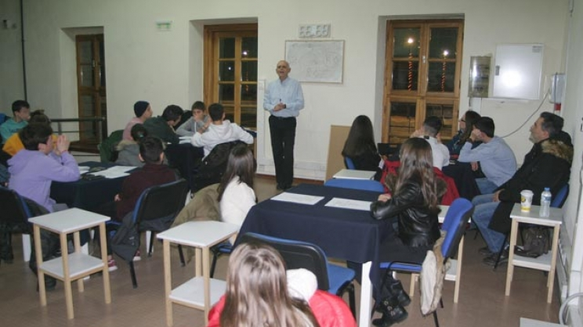
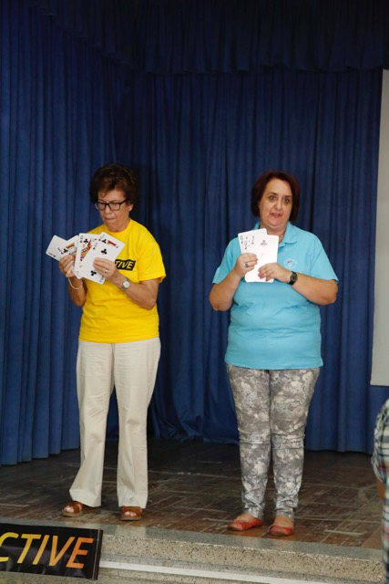
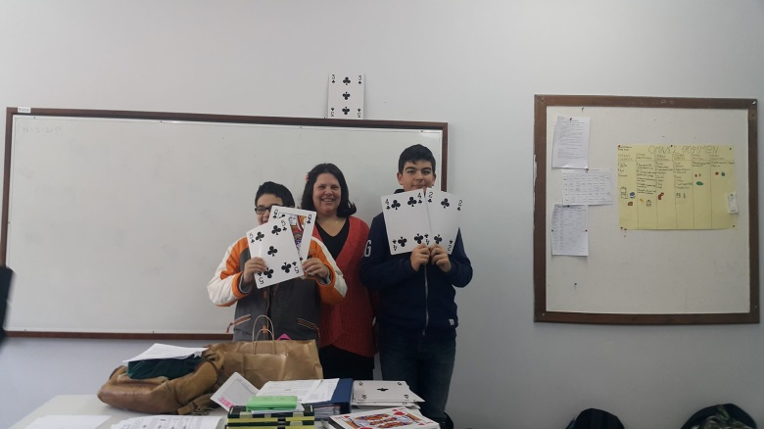
9th EBL NBO Officers’ Seminar
i. Presentation
Larisa
Nicosia (Cyprus)
Kalamata
European Bridge League

Slide 23
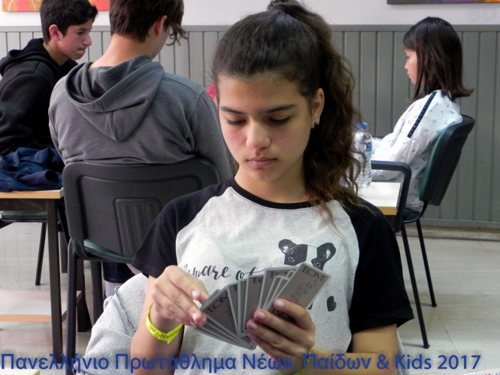
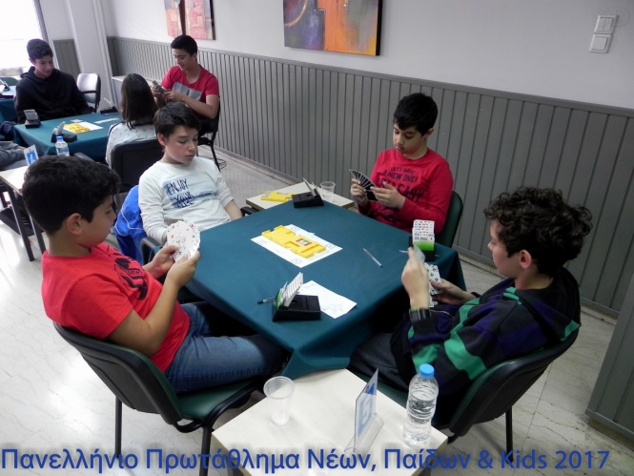
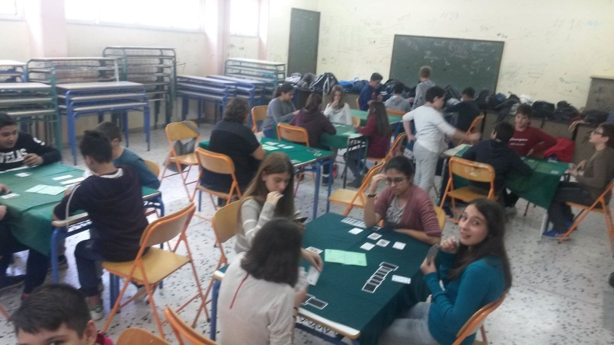
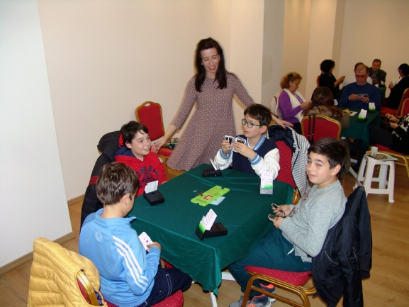
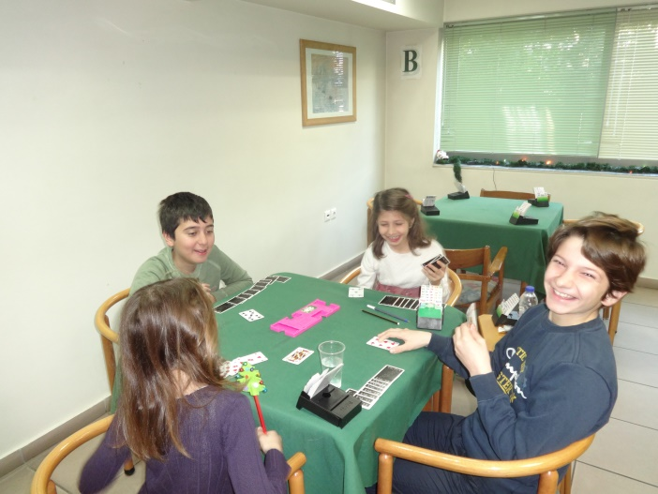
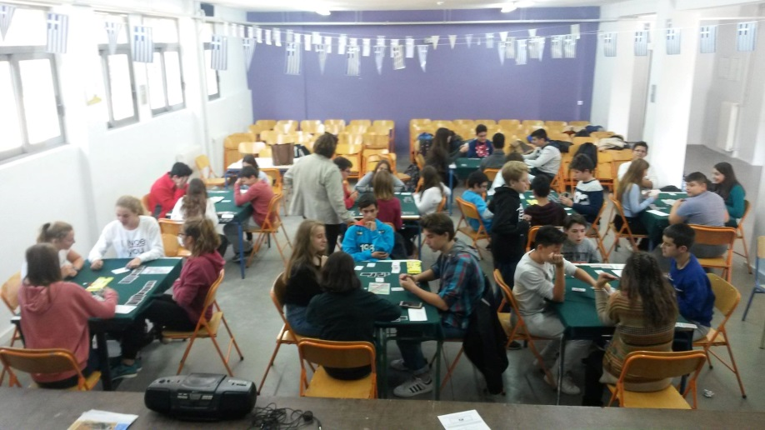
9th EBL NBO Officers’ Seminar
ii. Game
European Bridge League

Slide 24
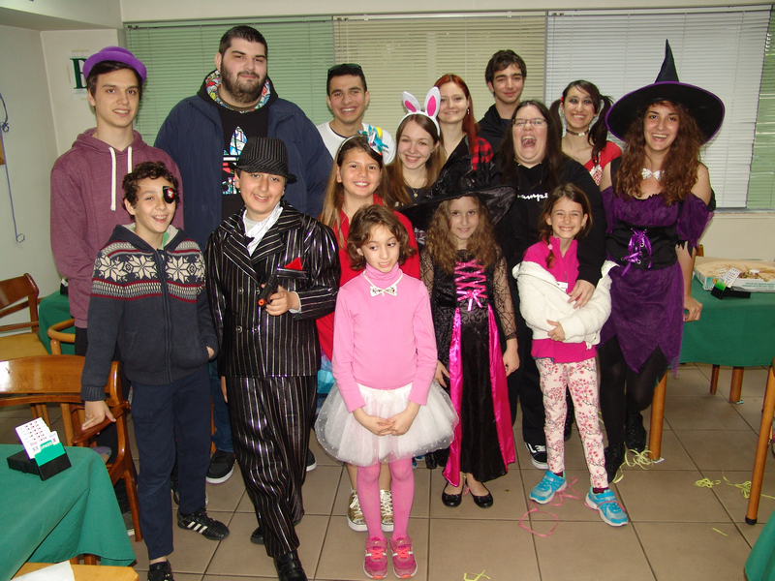
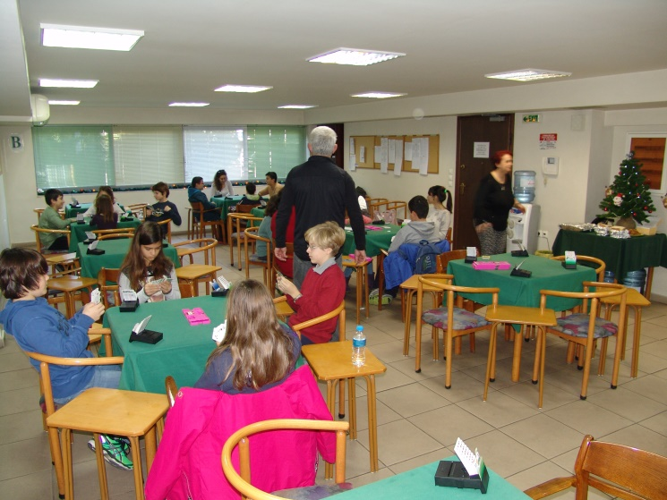
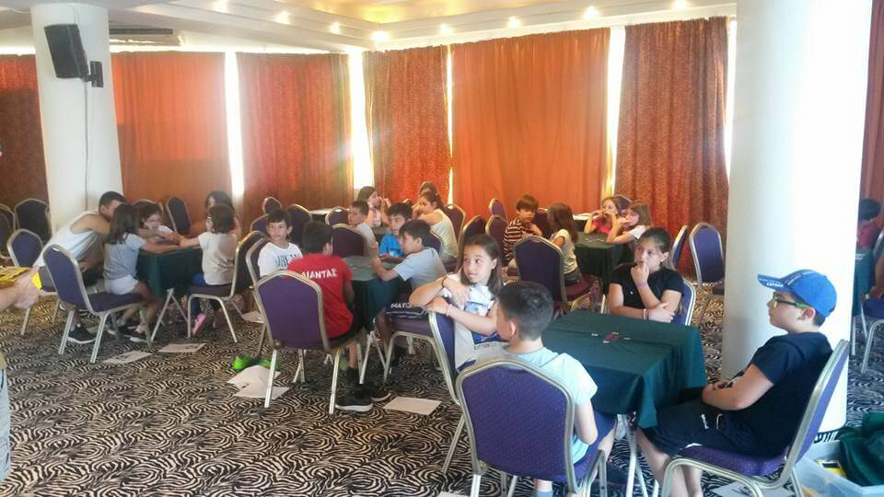
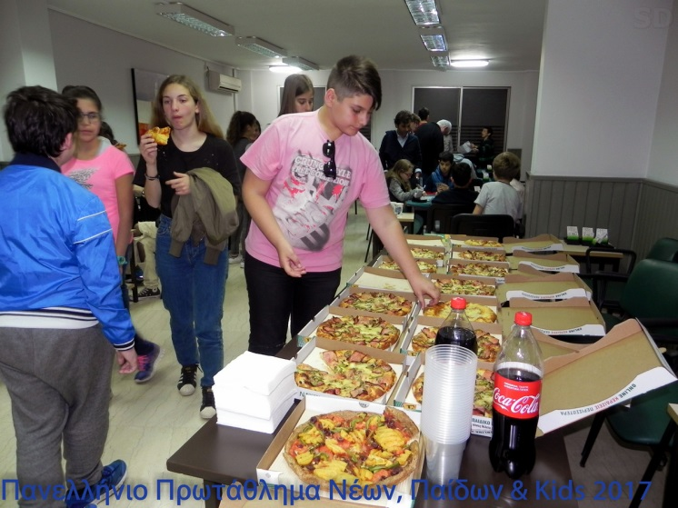
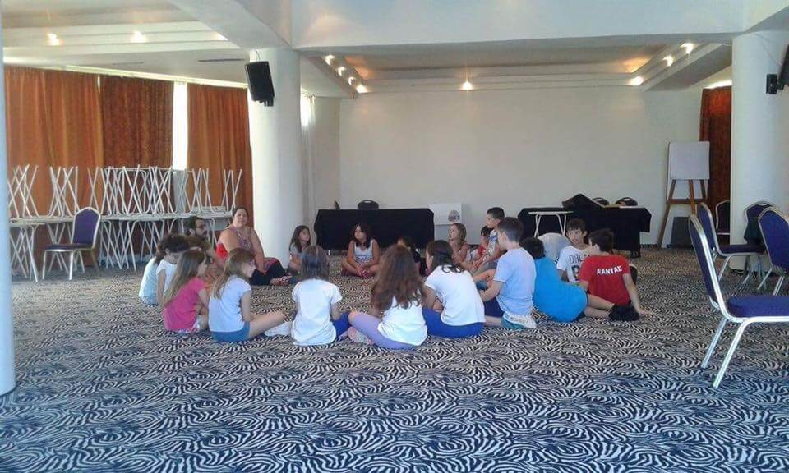
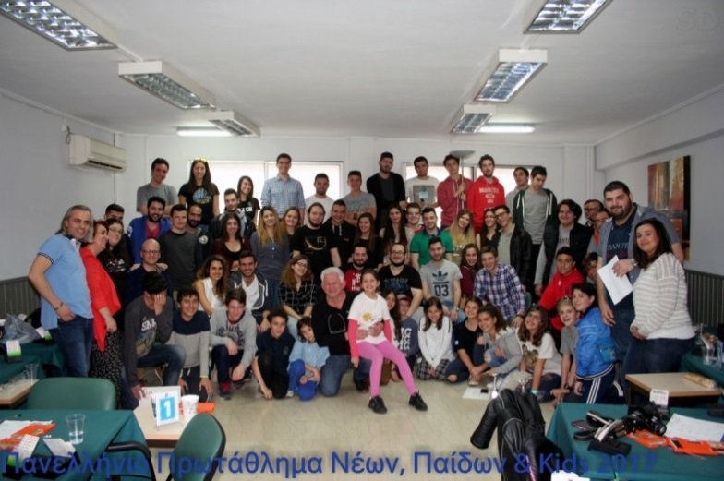
9th EBL NBO Officers’ Seminar
iii. Parties & Events
European Bridge League

Slide 25
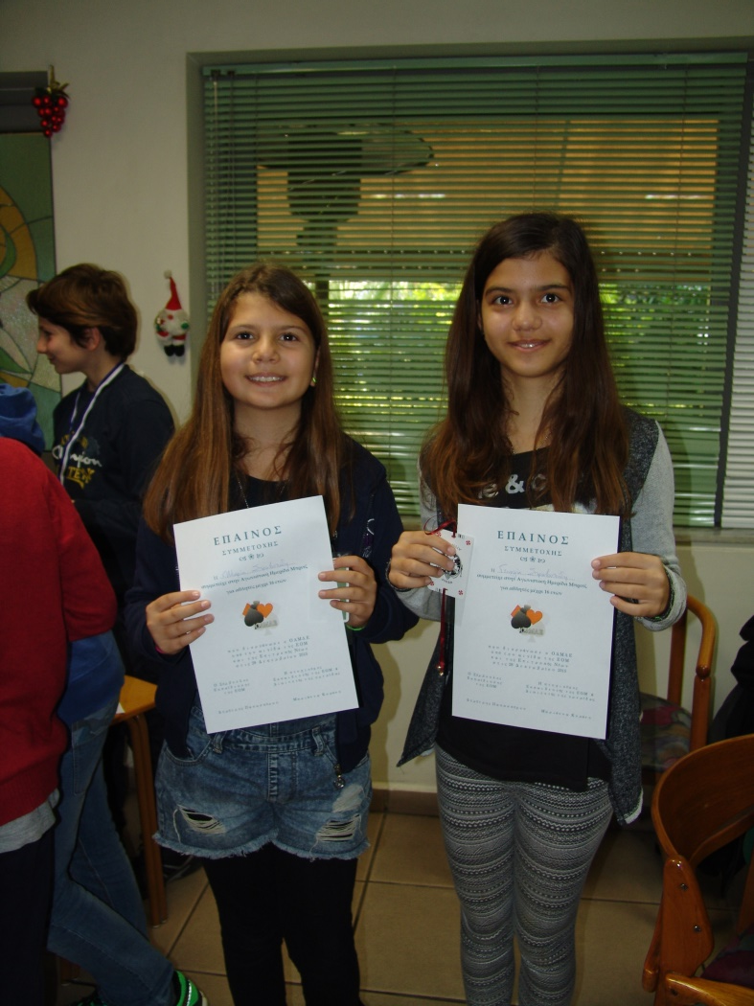
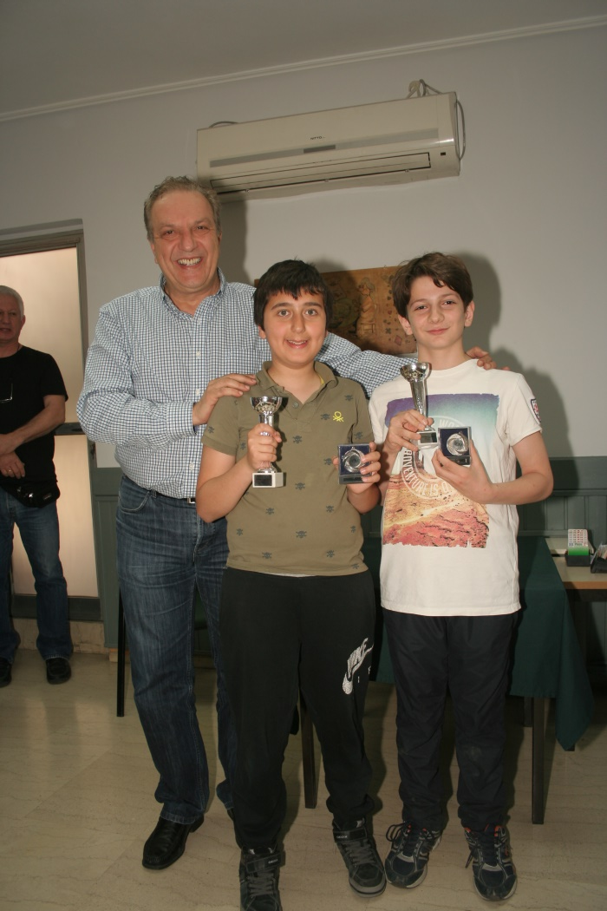
9th EBL NBO Officers’ Seminar
iv. Motives
European Bridge League

Slide 26
9th EBL NBO Officers’ Seminar
Problems & Dangers
Adults who refuse to play against children
Feeling uncomfortable
Afraid to lose
Addiction
Isolation
Abandoning studies
European Bridge League

Slide 27
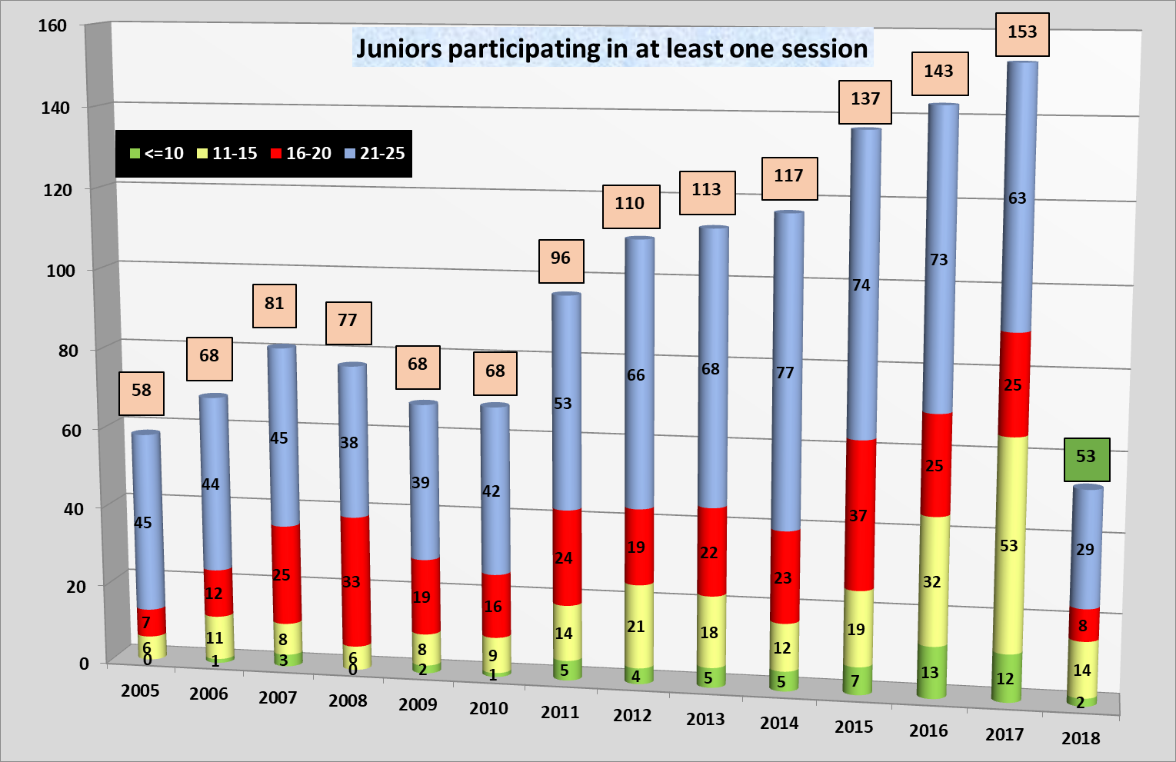
9th EBL NBO Officers’ Seminar
European Bridge League

Slide 28
9th EBL NBO Officers’ Seminar
2017 junior athlete identities
0-10: 6 , 7
11-15: 29 , 28
16-20: 23 , 14
21-25: 39 , 15
97
64
European Bridge League

Slide 29
9th EBL NBO Officers’ Seminar
Recent Championships
2016: 1st National Kids Championship
2017: 2nd National Kids Championship
2017: 1st Mini Bridge Championship
2018: School Championship in 3 cities
7
64
European Bridge League

Slide 30
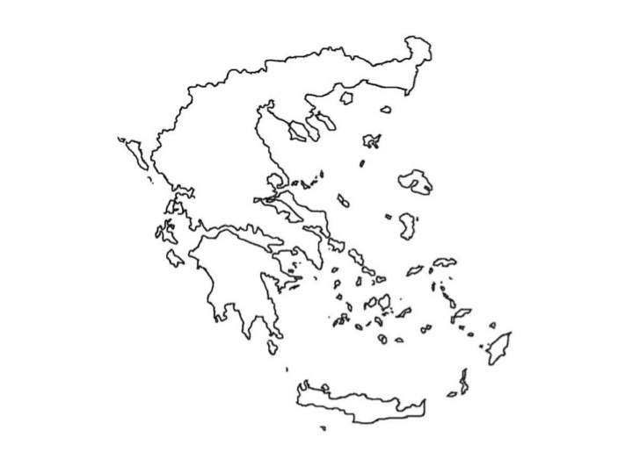
9th EBL NBO Officers’ Seminar
Serres
Kavala
Thessaloniki
Larissa
Agrinio
Patra
Athens
Kalamata
European Bridge League

Slide 31
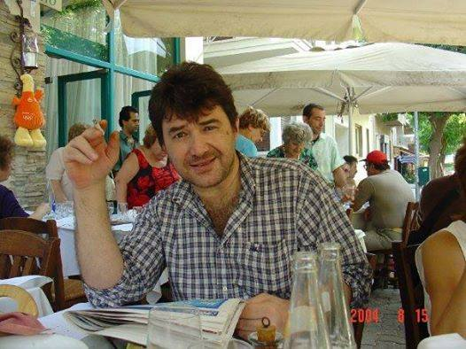
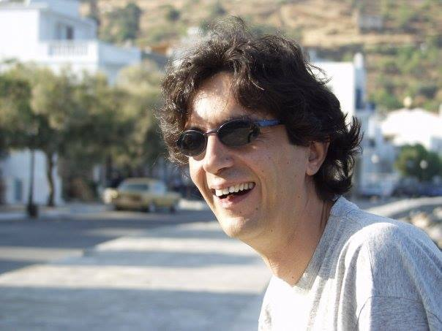
9th EBL NBO Officers’ Seminar
Dedicated to the memory of my teammates in Greek Junior Team 1986-1988
Thanos Kapayiannidis
Spyros Liarakos
Thank you for your attention
European Bridge League

